Slide 1
Shape cutout from screenshot
https://blog.slidemagic.com/blog/2018/1/9/how-to-cut-out-shapes-out-of-images-in-powerpoint

Slide 2
filter: none
Light:-48
Color:100%
clarity:100%
Vignette: -25
aspect ratio: 3.01

Slide 3


Slide 4


Slide 5


Slide 6
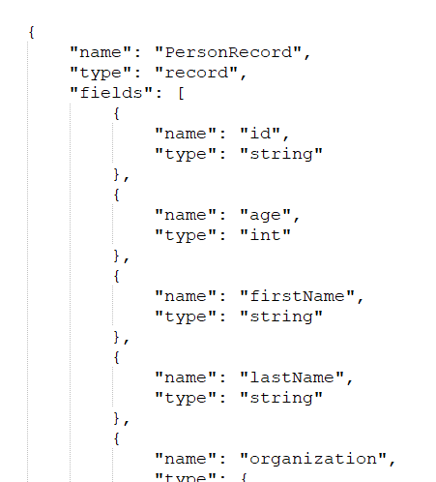
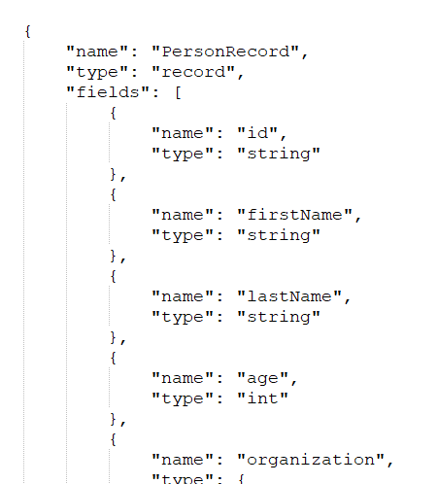
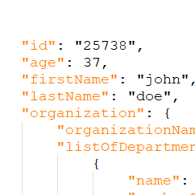
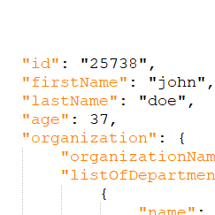
old schema
new schema
old record
new record

Slide 7
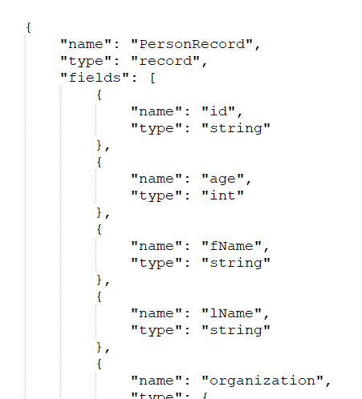
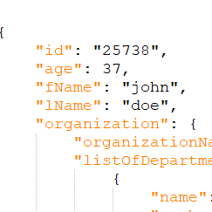
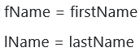
old schema
new schema
old record
new record
renamed list

Slide 8
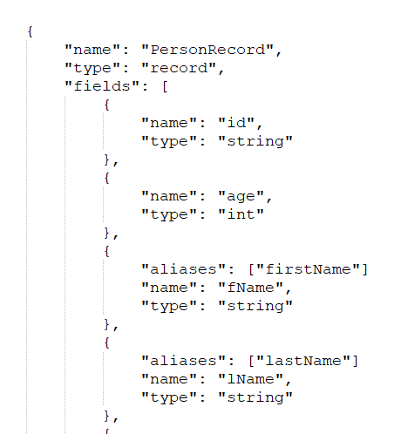
old schema
new schema
old record
new record

